Slide 1
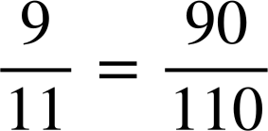
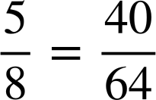
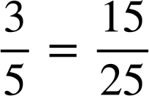
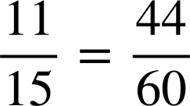
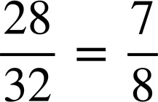
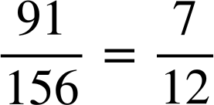
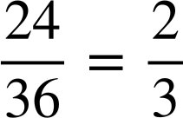
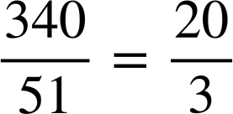
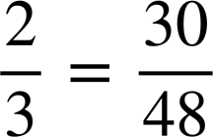
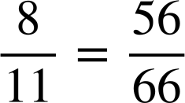
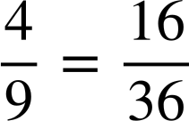
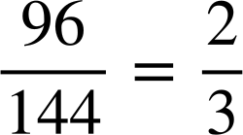
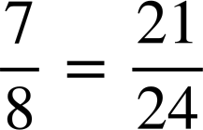
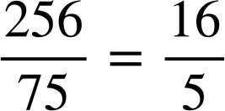
Ordering fractions by way of a common denominator
Task A: Review writing equivalent fractions
1) Fill in the missing numerator or denominator.
a)
e)
b)
f)
c)
g)
d)
h)
2) Which of the following are true?
a)
b)
c)
d)
e)
f)

Slide 2
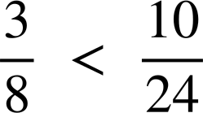
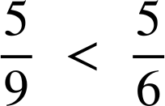
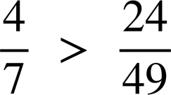
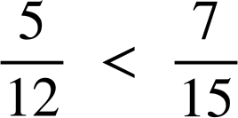


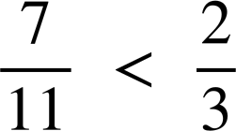
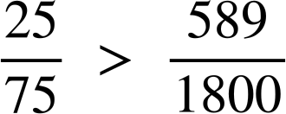



Ordering fractions by way of a common denominator
Task B: Comparing fractions
1) Use equivalent fractions to decide which fraction is greater.
Insert either < or > to make the statement true.
a)
e)
b)
f)
c)
g)
d)
h)
2)
Place the words ‘greater’ and ‘less’ in the sentence:
is than but than
Jacob says “ is exactly halfway between and .”
Is he correct?

Slide 3




Ordering fractions by way of a common denominator
Task C: Order fractions using equivalent fractions
Write the following fractions with a common denominator and order from smallest to largest.
a)
b)
c)
d)
Mathematics in Education and Industry
v2.1

